Slide 1
Module 9: Location and Maps
SER 423

Slide 2
Overview
Using the User’s location is a common feature in mobile applications
While the use of it can be controversial, it can be used to enhance the User’s experience with your app
One of the most common reasons for using the User’s location is to display where they are on a map
Even if we don’t display the map, we often check for points of interest around the User’s location
  Examples would be gas stations, restaurants, Pokẻ Stops, etc.
If we’re not looking at the area, or just showing the User where they are, why are we looking at their location?
Android and iOS both handle location and mapping a little differently

Slide 3
Location in Android

Slide 4
Getting Permissions
Android asks you to put your app into one of two categories
  Foreground - This is for making sporadic use of location, either only a single time or for a set period of time
  Background - This is when your app will continuously use and/or share location information
Which you want will depend largely on whether you want real time updates or not
You also need to specify which accuracy level you want
  Approximate - This is a rough estimate of the User’s location to within about 1.2 square miles (or about 3 square km)
  Precise - This provides a finer level of accuracy to within about 10 feet
    Some devices can do even better
You should not ask for more than you need on either of these, harder to convince people to allow it
You declare both of these in your Android Manifest

Slide 5
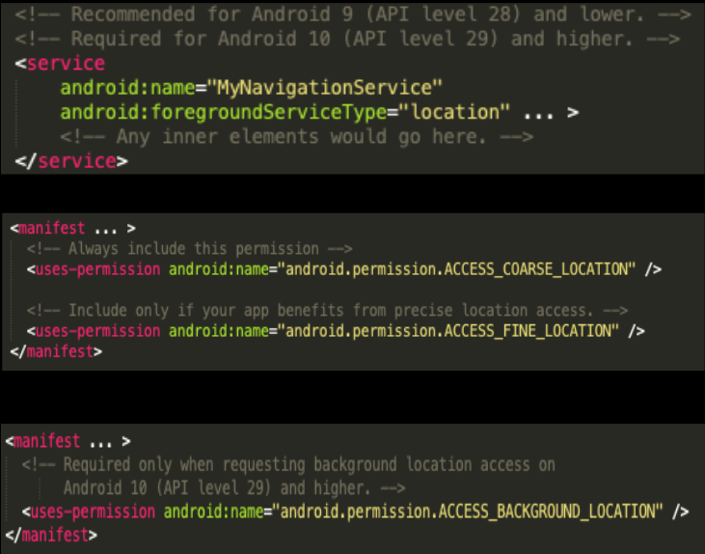
The Manifest

Slide 6
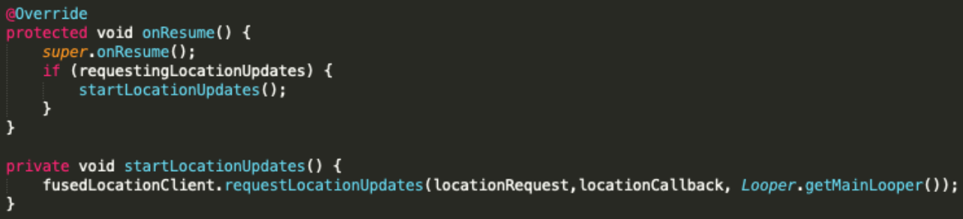
Making a Location Request

Slide 7
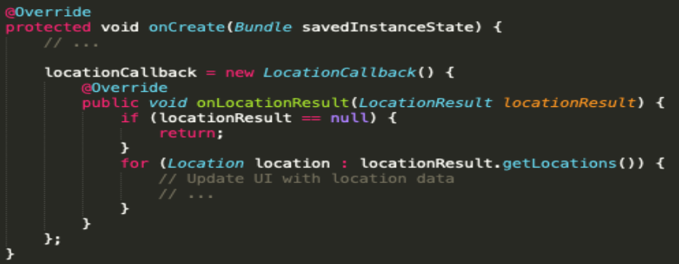
Handling the Response

Slide 8
Adding a Map
There’s the Maps SDK which contains several classes for managing the lifecycle and data of a map
The main interface for setting up a map is:
  GoogleMap
    This connects to the Google Maps service, downloads and displays map tiles, displays controls like zoom in and out, and handles those controls all built in
  SupportMapFragment - For managing the lifecycle of a GoogleMap
    Fragments are basically mini-views
  MapView - A view for handling the lifecycle of a GoogleMap
  OnMapReadyCallback - An interface for handling events and User interaction with the GoogleMap
Your app must retrieve the GoogleMap object from a SupportMapFragment or MapView in order to use it

Slide 9
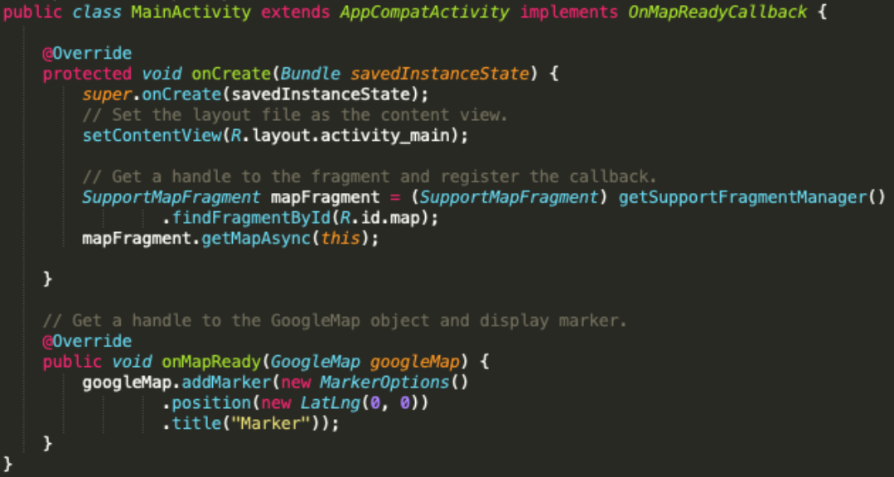
Map Creation Example

Slide 10
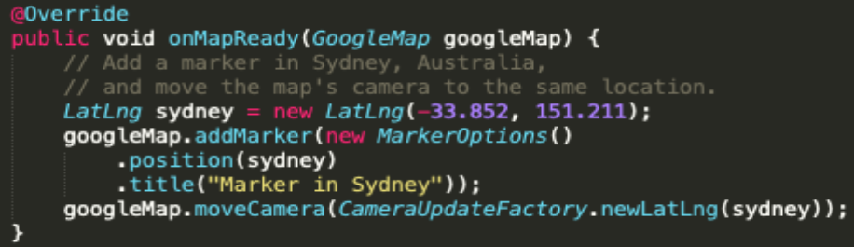
Adding Markers

Slide 11
Location in iOS

Slide 12
Permissions and APIs
You need permission to use location data here too so add it to your UIRequiredDeviceCapabilities key in your Info.plist file
Apps get location data through multiple classes that are part of the iOS Core Location framework
For getting the User’s current location, there are two services commonly used
  Standard Location Service - Good for real time, shuts off if the app is killed
  Significant Change Location Service - A good battery saving alternative if you don’t need good precision, continues even if app is killed
Regardless of which you use, you get the location from the Location Manager
This manager will report updates to the didUpdateLocations method of the delegate when they become available

Slide 13
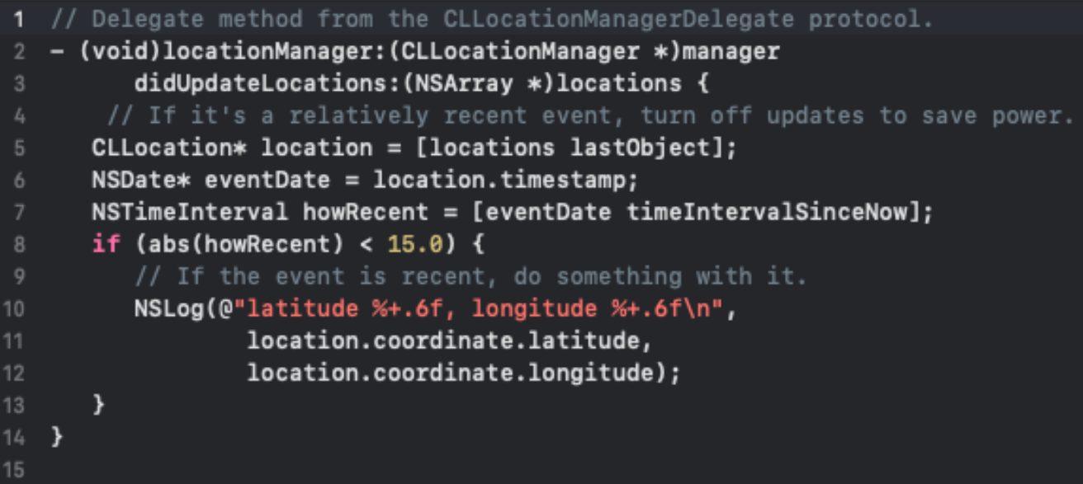
An Update Example

Slide 14
iOS Maps
These are a little more straightforward than Android
In iOS you will want to use the MKMapView class to present map data in your app
Three steps:
  Create an instance of the class
  Initialize it with the initWithFrame method
    This tells it where to start
    You can also specify a region here to get a zoom level you want
  Add it to the View hierarchy
MKMapViewDelegate is what will respond to User interactions
  You can use this

Slide 15
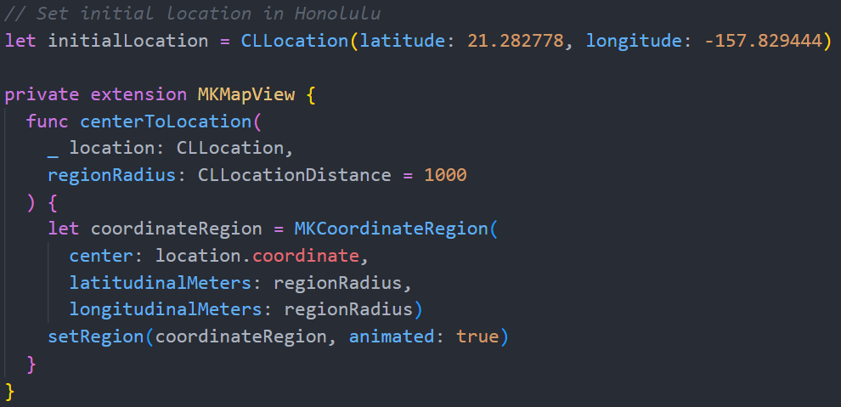
Initiating the Map

Slide 16
End of Location and Maps
Next time - Maps in React

